Slide 1
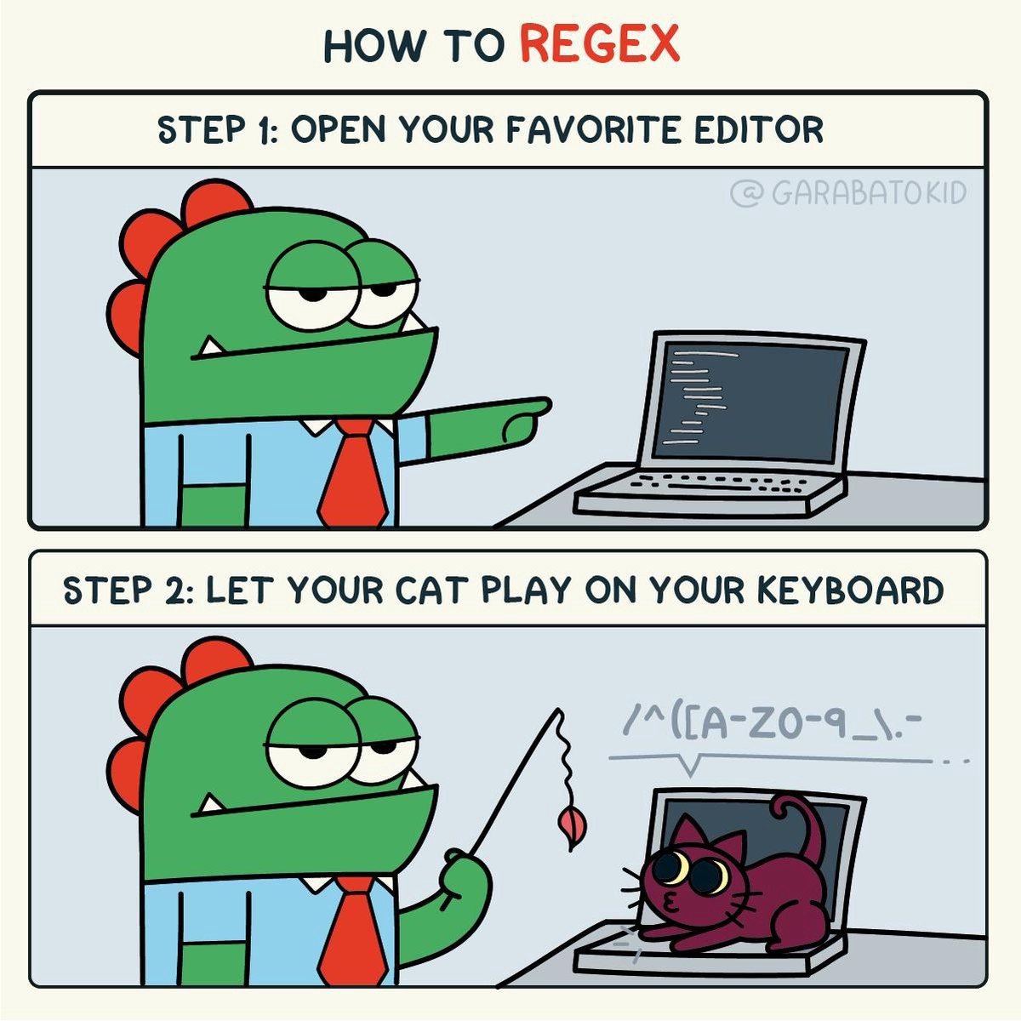
https://medium.com/@leerbardon/regular-expressions-c174ce78029f

Slide 2
Regular Expressions (RegEx)
Regex, or regular expressions, are special sequences used to find or match patterns in strings.
These sequences use metacharacters and other syntax to represent sets, ranges, or specific characters.
https://medium.com/@leerbardon/regular-expressions-c174ce78029f

Slide 3
Why use RegEx?
It is fast, powerful and extremely useful!
(and fun)
Most programming languages understands it.
Regular expressions have many real-world uses cases, which include:
Form-input validation
Web scraping
Search (and replace)
Filtering for information in massive text files (such as logs)
https://www.sitepoint.com/learn-regex/

Slide 4


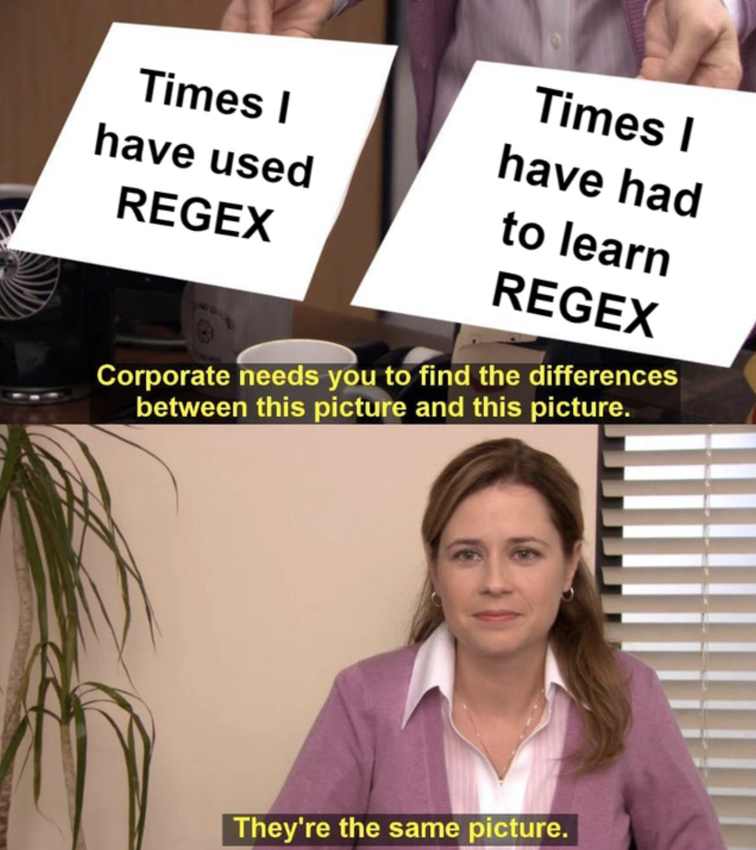
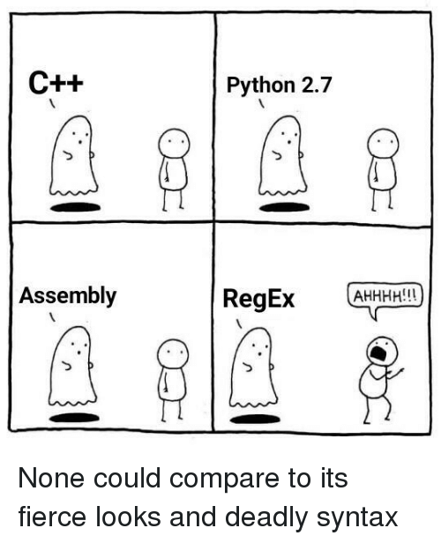
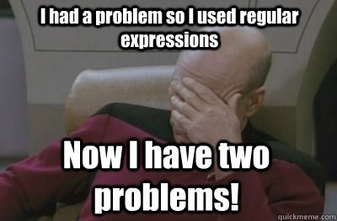
Why use RegEx?
The memes!
https://www.reddit.com/r/ProgrammerHumor/comments/aoktpr/regex_is_life/
https://medium.com/@sydcjohnson/regular-expression-for-dummies-1062e5d74b7a
https://www.reddit.com/r/ProgrammerHumor/comments/l1k4iy/every_time/
https://medium.com/@sydcjohnson/regular-expression-for-dummies-1062e5d74b7a
https://mtruongn93.github.io/blog/alternative-for-confusing-RegEx.html

Slide 5
RegEx terminology
Pattern: regular expression pattern
String: test string used to match the pattern
Digit: 0-9
Letter: a-z, A-Z
Symbol: !$%^&*()_+|~-=`{}[]:”;'<>?,./
Space: single white space, tab
Character: refers to a letter, digit or symbol
https://www.sitepoint.com/learn-regex/

Slide 6
Common Python usage
re.findall(RegEx, str to find it in) matches all instances and returns in a list.
re.search(RegEx, str to find it in) matches only the first instance.
re.split(RegEx) extracts specific sections of a string (usually used after findall).
re.sub(RegEx, replace str, original str) substitutes part of a string for something else.

Slide 7
Common Regular Expressions
For more: see commonRegEx.md

Slide 8
Regular Expressions Cheat Sheet
For more: see cheatRegEx.md

Slide 9
RegEx101 - Basics
First, lets try to match the word cat in this string: rat bat cat sat fat cats eat tat cat mat CAT
https://www.sitepoint.com/learn-regex/

Slide 10
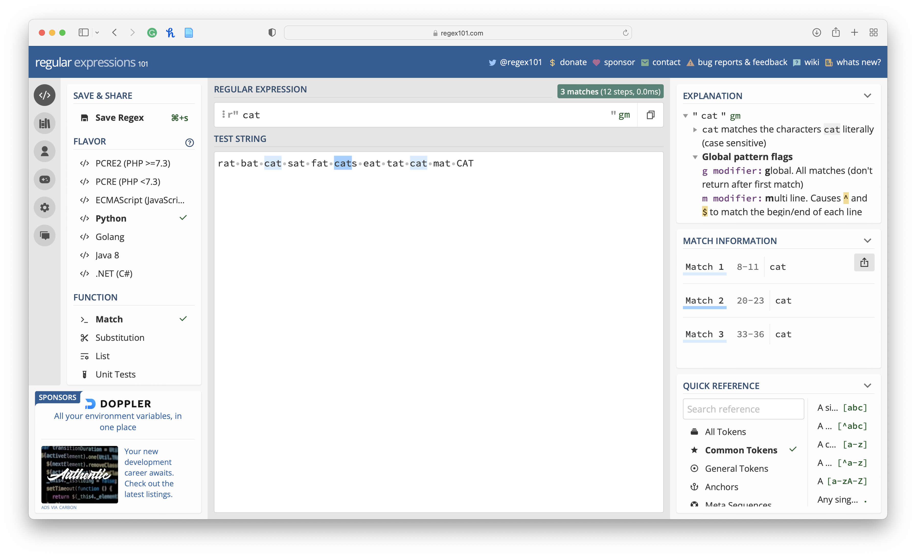
RegEx101 - Basics
https://www.sitepoint.com/learn-regex/

Slide 11
RegEx101 - Flag
As we can see, this is can see sensitive and will only match the word that are identical.
We can make it insensitive by changing the flag.
This will make it possible to match all the cats ☺
https://www.sitepoint.com/learn-regex/

Slide 12
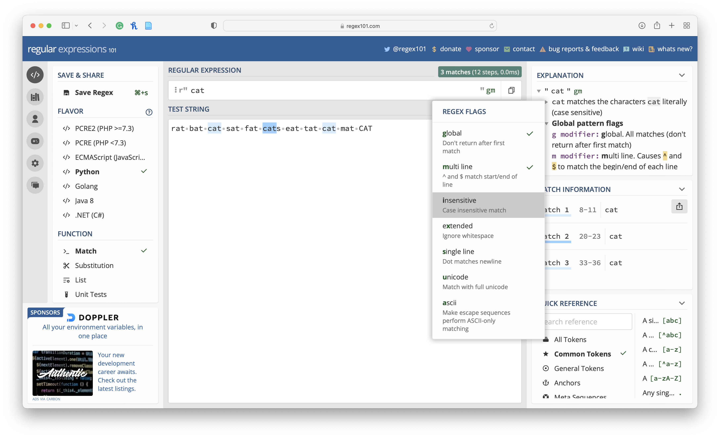
RegEx101 - Flag
https://www.sitepoint.com/learn-regex/

Slide 13
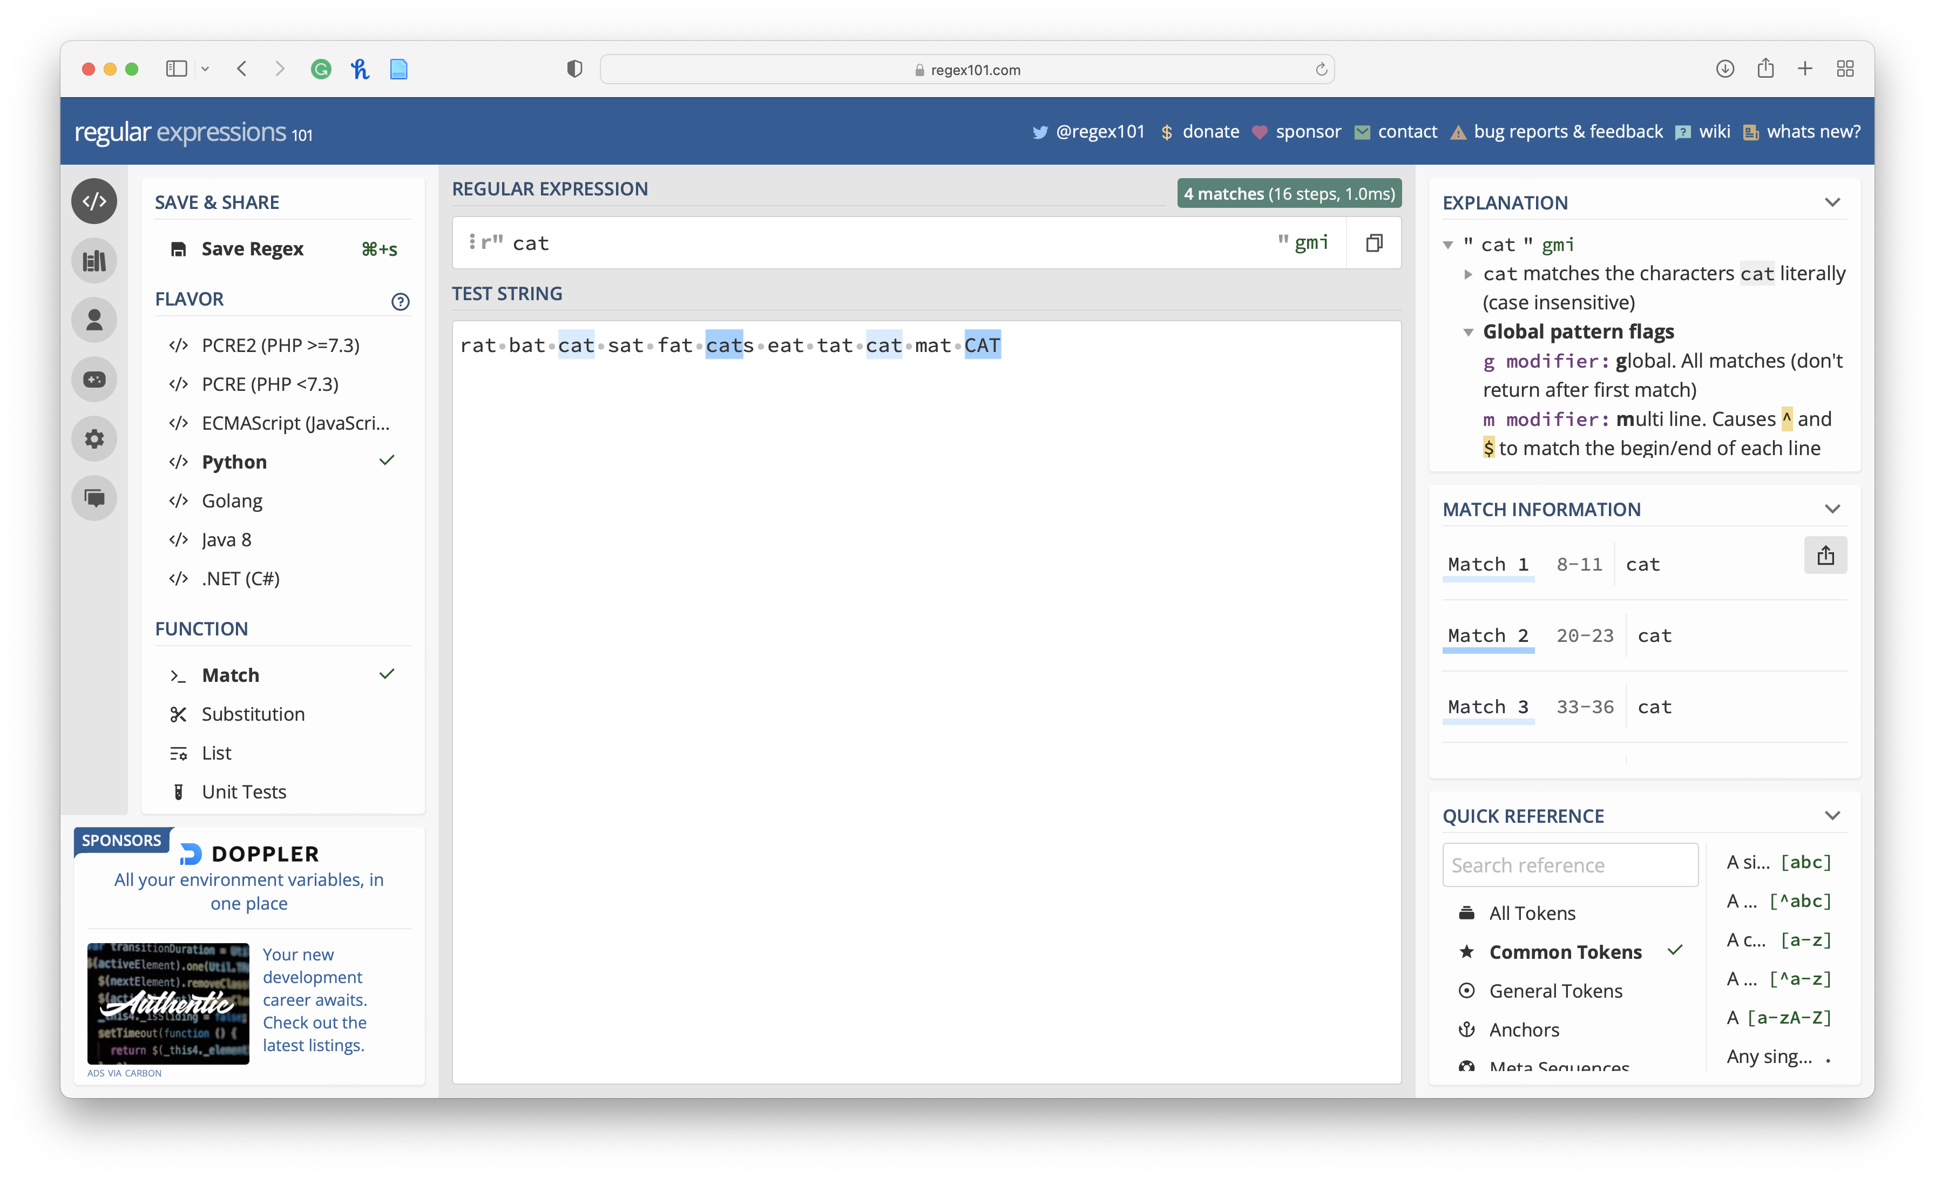
RegEx101 - Flag
https://www.sitepoint.com/learn-regex/

Slide 14
RegEx101 - Character Sets
If we wanted to match “bat”, “cat”, and “fat”, can we do this by using character sets, denoted with [] (brackets).
Basically, you put in multiple characters that you want to get matched.
For example, [bcf]at will match multiple strings as follows:
https://www.sitepoint.com/learn-regex/

Slide 15
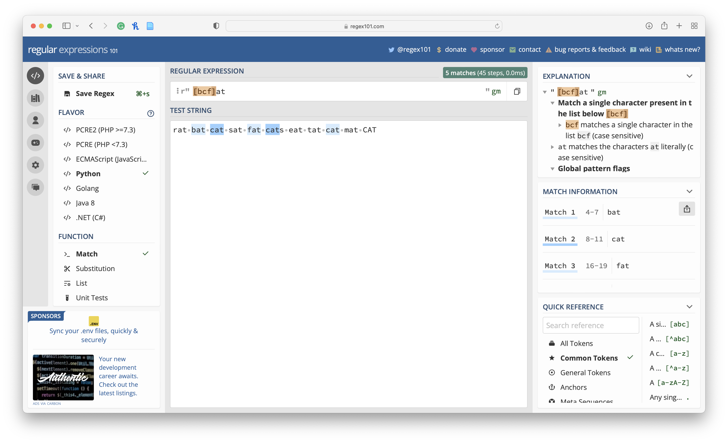
RegEx101 - Character Sets
https://www.sitepoint.com/learn-regex/

Slide 16
RegEx101 - Ranges
Let’s assume we want to match all words that end with at.
We could supply the full alphabet inside the character set, but that would be tedious.
The solution is to use ranges like this [a-z]at:
https://www.sitepoint.com/learn-regex/

Slide 17
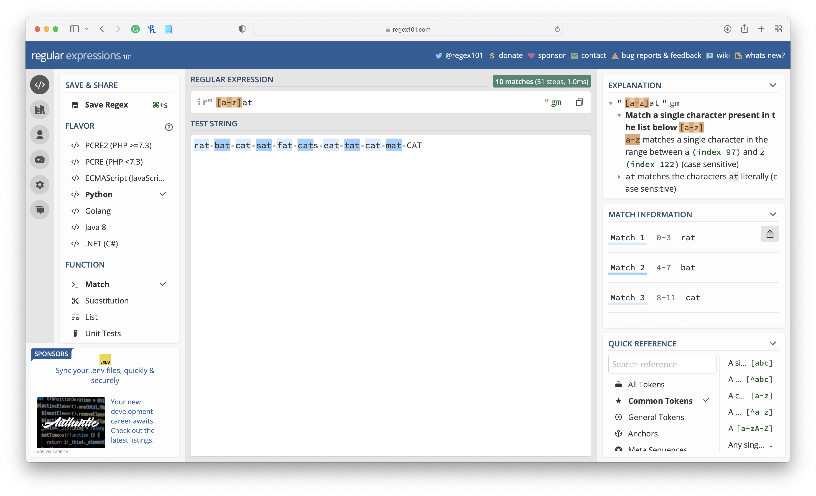
RegEx101 - Ranges
https://www.sitepoint.com/learn-regex/

Slide 18
RegEx101 - Ranges
Partial range: selections such as [a-f] or [g-p].
Capitalized range: [A-Z].
Digit range: [0-9].
Symbol range: for example, [#$%&@].
Mixed range: for example, [a-zA-Z0-9] includes all digits, lower and upper case letters.
Do note that a range only specifies multiple alternatives for a single character in a pattern.
https://www.sitepoint.com/learn-regex/

Slide 19
RegEx101 - Repeating Characters
Let’s say you’d like to match all three-letter words. You’d probably do it like this: [a-z][a-z][a-z]
This would match all three-letter words.
But what if you want to match a five- or eight-character word?
There’s a better way to express such a pattern using the {} curly braces notation.
All you have to do is specify the number of repeating characters.
https://www.sitepoint.com/learn-regex/

Slide 20
RegEx101 - Repeating Characters
Here are examples:
a{5} will match “aaaaa”.
n{3} will match “nnn”.
[a-z]{4} will match any four-letter word such as “door”, “room” or “book”.
[a-z]{6,} will match any word with six or more letters.
[a-z]{8,11} will match any word between eight and 11 letters.
[0-9]{11} will match an 11-digit number.
https://www.sitepoint.com/learn-regex/

Slide 21
RegEx101 - Metacharacters
Metacharacters allow you to write regular expression patterns that are even more compact!
\d matches any digit that is the same as [0-9]
\w matches any letter, digit and underscore character
\s matches a whitespace character — that is, a space or tab
\t matches a tab character only
https://www.sitepoint.com/learn-regex/

Slide 22
RegEx101 - Metacharacters
Here are some exampels:
\w{5} matches any five-letter word or a five-digit number
\d{11} matches an 11-digit number
https://www.sitepoint.com/learn-regex/

Slide 23
RegEx101 - Special Characters
Special characters take us a step further into writing more advanced pattern expressions:
+ : One or more quantifiers (preceding character must exist and can be optionally duplicated).
For example, the expression c+at will match “cat”, “ccat” and “ccccccccat”. You can repeat the preceding character as many times as you like and you’ll still get a match.
? : Zero or one quantifier (preceding character is optional).
For example, the expression c?at will only match “cat” or “at”.
https://www.sitepoint.com/learn-regex/

Slide 24
RegEx101 - Special Characters
* : Zero or more quantifier (preceding character is optional and can be optionally duplicated).
For example, the expression c*at will match “at”, “cat” and “ccccccat”.
It’s like the combination of + and ?.
\ : this “escape character” is used when we want to use a special character literally.
For example, c\* will exactly match “c*” and not “ccccccc”.
https://www.sitepoint.com/learn-regex/

Slide 25
RegEx101 - Special Characters
[^]: this “negate” notation is used to indicate a character that should not be matched within a range.
For example, the expression b[^a-c]ld will not match “bald” or “bbld” because the second letters a to c are negative.
However, the pattern will match “beld”, “bild”, “bold” and so forth.
. : this “do” notation will match any digit, letter or symbol except newline.
For example, .{8} will match a an eight-character password consisting of letters, numbers and symbols. for example, “password” and “P@ssw0rd” will both match.
https://www.sitepoint.com/learn-regex/

Slide 26
RegEx101 - Special Characters
From what we’ve learned so far, we can create an interesting variety of compact but powerful regular expressions.
For example:
.+ matches one or an unlimited number of characters. For example, “c” , “cc” and “bcd#.670” will all match.
[a-z]+ will match all lowercase letter words irrespective of length, as long as they contain at least one letter. For example, “book” and “boardroom” will both match.
https://www.sitepoint.com/learn-regex/

Slide 27
RegEx101 - Groups
All the special characters we just mentioned only affect a single character or a range set.
What if we wanted the effect to apply to a section of the expression?
We can do this by creating groups using round brackets — ().
For example, the pattern book(.com)?
will match both “book” and “book.com”, since we’ve made the “.com” part optional.
Here’s a more complex example that would be used in a realistic scenario such as email validation:
https://www.sitepoint.com/learn-regex/

Slide 28
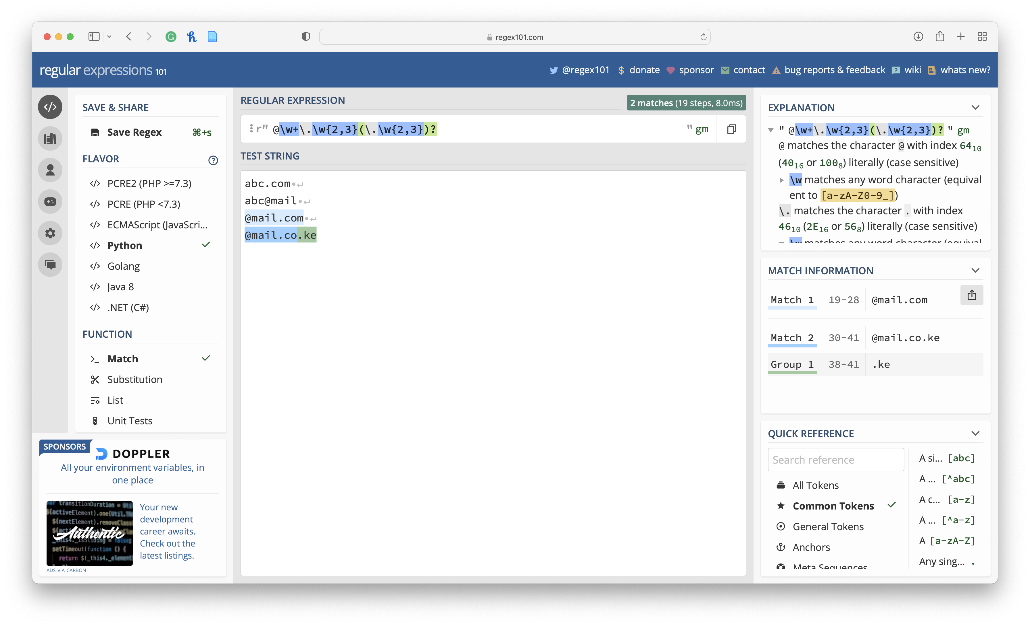
RegEx101 - Groups
https://www.sitepoint.com/learn-regex/

Slide 29
RegEx101 - Alternate Characters
We can specify alternate characters using the “pipe” symbol: |
This is different from the special characters we showed earlier, as it affects all the characters on each side of the pipe symbol.
For example, the pattern sat|sit will match both “sat” and “sit” strings.
We can rewrite the pattern as s(a|i)t to match the same strings.

Slide 30
RegEx101 - Starting and Ending Patterns
You may have noticed that some positive matches are a result of partial matching.
For example, if I wrote a pattern to match the string “boo”, the string “book” will get a positive match as well, despite not being an exact match.
To remedy this, we’ll use the following notations:
https://www.sitepoint.com/learn-regex/

Slide 31
RegEx101 - Starting and Ending Patterns
^ : placed at the start, this character matches a pattern at the start of a string.
$ : placed at the end, this character matches a pattern at the end of the string.
https://www.sitepoint.com/learn-regex/

Slide 32
RegEx101 - Starting and Ending Patterns
To fix the above situation, we can write our pattern as boo$.
This will ensure that the last three characters match the pattern.
However, there’s one problem we haven’t considered yet, as the following image shows:
https://www.sitepoint.com/learn-regex/

Slide 33

RegEx101 - Starting and Ending Patterns
https://www.sitepoint.com/learn-regex/

Slide 34
RegEx101 - Starting and Ending Patterns
The string “sboo” and “booboo” get a match because they still fulfill the current pattern-matching requirements.
To fix this, we can update the pattern as follows: ^boo$
This will strictly match the word “boo”.
If you use both of them, both rules are enforced.
For example, ^[a-z]{5}$ strictly matches a five-letter word.
If the string has more than five letters, the pattern doesn’t match.
https://www.sitepoint.com/learn-regex/

Slide 35
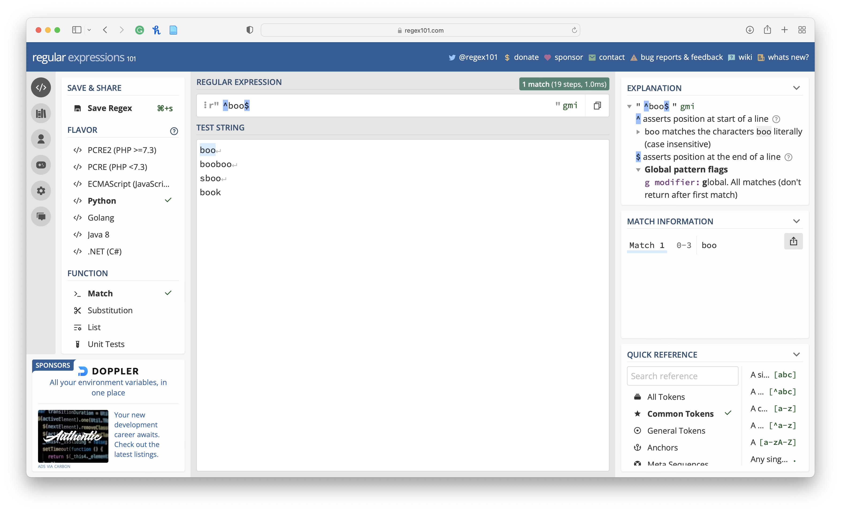
RegEx101 - Starting and Ending Patterns
https://www.sitepoint.com/learn-regex/

